Slide 1

Web Application Development
COMP-229

Slide 2
Web Application Development
Download and Install 3rd party npm modules

Slide 3
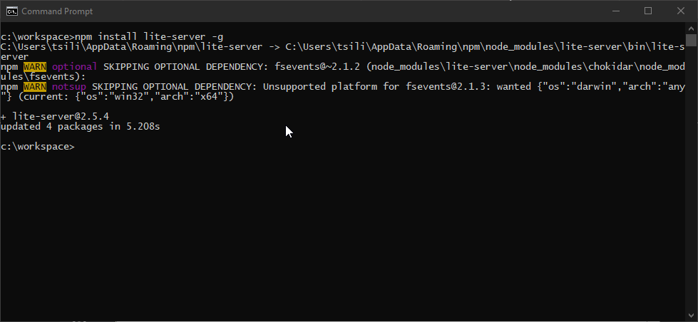
Download and Install 3rd party npm modules
We will be using several npm packages to assist with our app development.
Open a command prompt and issue the following command:
npm install lite-server –g
This will install a small node server to use for our initial testing of Visual Studio Code and JavaScript

Slide 4
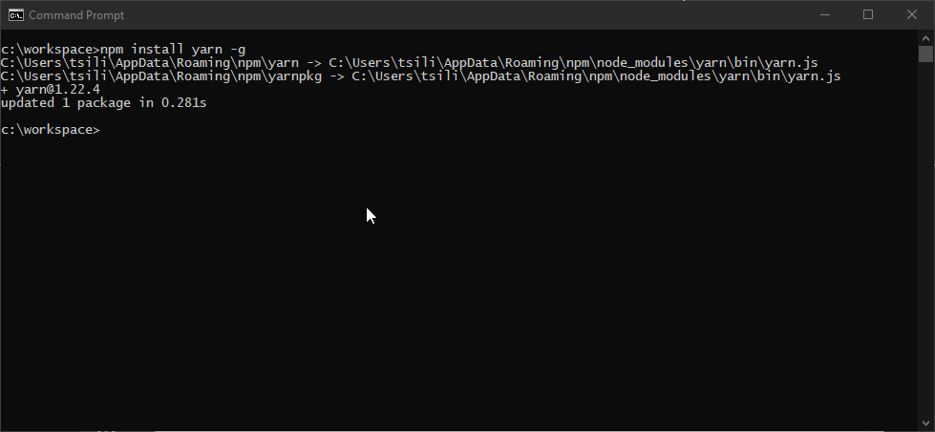

Download and Install 3rd party npm modules (continued)
Next, issue the following command:
npm install yarn –g
This will install the yarn package manager which we will use to install npm packages for the front end of our application.

Slide 5
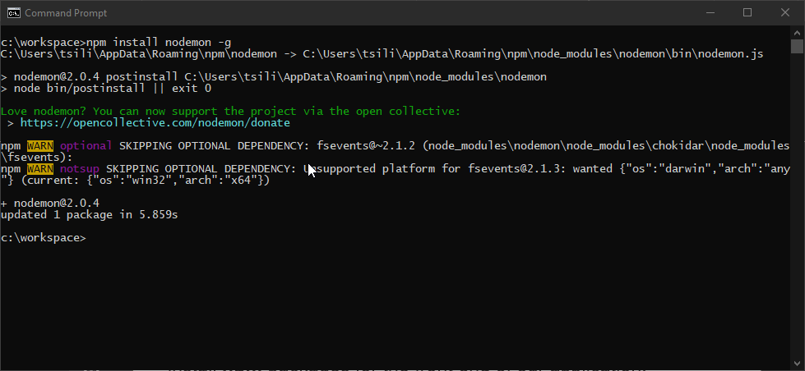
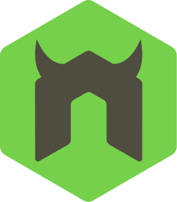
Download and Install 3rd party npm modules (continued)
Next, issue the following command:
npm install nodemon –g
We will use this package when we test our nodeJS applications

Slide 6


Download and Install 3rd party npm modules (continued)
Next, issue the following command:
npm install typescript –g
TypeScript is a superset of JavaScript that makes writing JavaScript easier.
We will use TypeScript to develop our Angular Applications.
See https://www.typescriptlang.org/ for more details

Slide 7
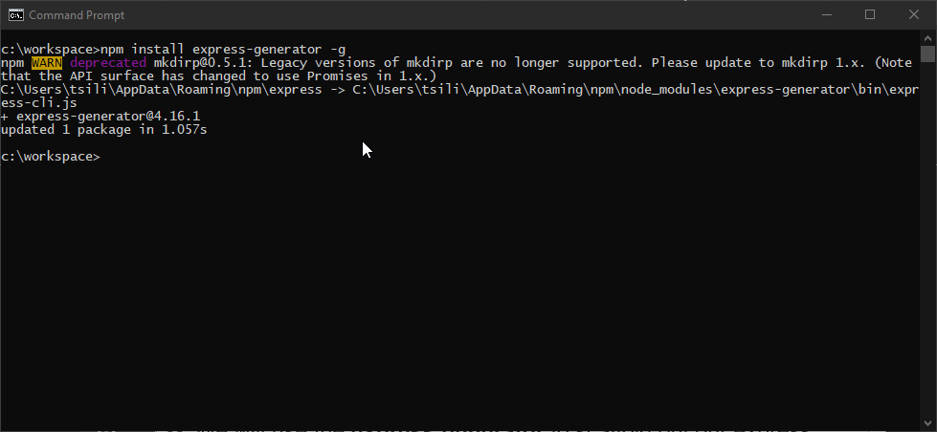

Download and Install 3rd party npm modules (continued)
Finall, issue the following command:
npm install express-generator –g
We will use the express generator to scaffold out our express applications

